Slide 1
Employee Attrition and Performance
Group 6
Srikanth Parvathala (Project Manager)
Sakshi Patil (Subject Matter Analyst)
Harshitha Ramachandra (Technical Analyst)
Angela Tseng (Technical Analyst)

Slide 2
Research Question
Unit of Analysis
Independent Variable
Individuals: employee
Monthly Income
Does monthly income have an impact on employee job attrition?
Tools
Logistic Regression
Descriptive statistics
Histogram
Dependent Variable
Attrition: Yes/No

Slide 3
IBM HR Analysis Employee Attrition and Performance
01
Attrition
Categorical ordinal
02
Monthly Income
IBM HR Employee Attrition Database
Numerical discrete
35 attributes
1470 records
03
Job Satisfaction
Categorical ordinal
04
Work Life Balance
Categorical ordinal

Slide 4
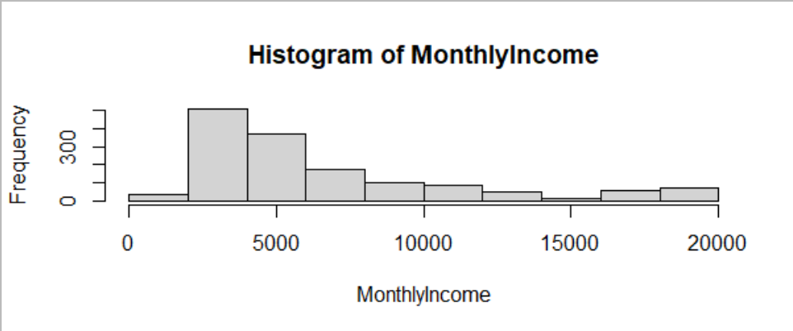
Analysis
> levels(df$Attrition)
[1] "Yes" "No"
Monthly income:
Min. 1st Qu. Median Mean 3rd Qu. Max.
1009 2911 4919 6503 8379 19999
Dependent variable is categorical with two levels and independent variable is numeric(discrete).
Descriptive Statistics
Histogram
Logistic Regression
Attrition

Slide 5
Statistical analysis
Null Hypothesis
Alternative Hypothesis
01
02
Ho: b1=0
There is no significant relationship between Monthly Income and Attrition.
Ha : b1 != 0
There is a significant relationship between Monthly Income and Attrition.
Monthly income has a significant effect on Job Attrition
Logistic Regression
Coefficients
03
fit <- glm(df$Attrition ~ df$MonthlyIncome, family=binomial())
Estimate Std.Error z value Pr(>|z|)
(Intercept) -9.291e-01 1.292e-01 -7.191 6.43e-13
df$MonthlyIncome -1.271e-04 2.162e-05 -5.879 4.12e-09

Slide 6

Interpretation of Result
where
bo= -0.929
b1= 0.000127
The p value associated with coefficient obtained is 4.12e-09 which is less than the significance level(0.05), hence based on our p value we reject the null hypothesis.
01
This implies that monthly income has a significant effect on Job Attrition.
02
Each one unit change in monthly income will decrease the log odds of determining attrition by 0.000127.
03

Slide 7
Impact of other Independent Variables
Chi Square Test of Independence for “JobSatisfaction” and “Attrition”
Chi Square Test of Independence for “WorkLifeBalance” and “Attrition”
H0
01
H0
There is no relationship between Job Satisfaction and Attrition
There is no relationship between WorkLifeBalance and Attrition
HA
HA
There is a relationship between Job Satisfaction and Attrition
02
There is a relationship between WorkLifeBalance and Attrition
Output
Output
X-squared = 17.505, df = 3, p-value = 0.0005563
03
X-squared = 16.325, df = 3, p-value = 0.0009726
Interpretation
Reject our null hypothesis: we conclude that there is a significant relationship between Job Satisfaction and Attrition.
Interpretation
04
Reject our null hypothesis: we conclude that there is a significant relationship between WorkLifeBalance and Attrition.

Slide 8
Further Analysis
glm(formula = df$Attrition ~ df$MonthlyIncome + df$WorkLifeBalance +
df$JobSatisfaction, family = binomial())
 | Estimate | Std. Error | z value | Error Pr(>|z|)
(Intercept) | 3.769e-01 | 3.026e-01 | 1.245 | 0.21300
df$MonthlyIncome | -1.280e-04 | 2.176e-05 | -5.884 | 4.01e-09 ***
df$WorkLifeBalance2 | -7.615e-01 | 2.896e-01 | -2.630 | 0.00855 **
df$WorkLifeBalance3 | -9.994e-01 | 2.678e-01 | -3.732 | 0.00019 ***
df$WorkLifeBalance4 | -6.967e-01 | 3.307e-01 | -2.107 | 0.03511*
df$JobSatisfaction2 | -4.535e-01 | 2.191e-01 | -2.070 | 0.03844*
df$JobSatisfaction3 | -4.283e-01 | 1.946e-01 | -2.201 | 0.02771 *
df$JobSatisfaction4 | -8.910e-01 | 2.080e-01 | -4.284 | 1.83e-05 ***
From the below result, it is observed that all the variables have a p value less than .05. Hence we reject the null hypothesis that the coefficient is equal to zero. Monthly Income, Work life balance and Job satisfaction has a significant impact on the attrition.

Slide 9
Limitations
Dataset doesn’t consist of details of the company that employees joined after leaving current job.
Fictional data set created by IBM data scientists
This data will help us to analysis further regarding outsourcing or poaching which is also one of the main factor for attrition in IT companies.
Notes:
This is a fictional data set created by IBM data scientists.
Dataset doesn’t consist of details of the company employees joined after leaving current job. This data will help us to analysis further regarding outsourcing or poaching which is also one of the main factor for attrition in IT companies.

Slide 10
Conclusion
Monthly income has a significant impact on Attrition.
01
For future analysis one can consider the bottom up approach, with other attributes from the dataset as independent variables to determine how probability of attrition varies.
Higher the Job Satisfaction lower the attrition rate, similarly higher the Work life balance lower the attrition rate.
03
02
Notes:
People who have less monthly income (mean : 4787.093 ) are more likely to leave their job as compared to those who have higher monthly income (mean: 6832.740 ).
Higher the Job Satisfaction lower the attrition rate, similarly higher the Work life balance lower the attrition rate.
For future analysis one can consider independent attributes such as Department, Education Field, Performance Rating and Job Role to predict Attrition.

Slide 11
THANK YOU!

Slide 12
Further Analysis
> fit1 <- glm(df$Attrition ~ df$MonthlyIncome + df$WorkLifeBalance + df$JobSatisfaction, family=binomial())
> summary(fit1)
Call:
glm(formula = df$Attrition ~ df$MonthlyIncome + df$WorkLifeBalance +
df$JobSatisfaction, family = binomial())
From the below result, it is observed that all the variables have a p value less than .05. Hence we reject the null hypothesis that the coefficient is equal to zero. Monthly Income, Work life balance and Job satisfaction has a significant impact on the attrition.
 | Estimate | Std. Error | z value | Error Pr(>|z|)
(Intercept) | 3.769e-01 | 3.026e-01 | 1.245 | 0.21300
df$MonthlyIncome | -1.280e-04 | 2.176e-05 | -5.884 | 4.01e-09 ***
df$WorkLifeBalance2 | -7.615e-01 | 2.896e-01 | -2.630 | 0.00855 **
df$WorkLifeBalance3 | -9.994e-01 | 2.678e-01 | -3.732 | 0.00019 ***
df$WorkLifeBalance4 | -6.967e-01 | 3.307e-01 | -2.107 | 0.03511*
df$JobSatisfaction2 | -4.535e-01 | 2.191e-01 | -2.070 | 0.03844*
df$JobSatisfaction3 | -4.283e-01 | 1.946e-01 | -2.201 | 0.02771 *
df$JobSatisfaction4 | -8.910e-01 | 2.080e-01 | -4.284 | 1.83e-05 ***

